Slide 1
Electronics Lab (Experiment-1C)
Nikhil Bharat Rajani (21IE10026)
P . Manoj Kumar (21IE10027)
P. Nethaji (21IE10029)

Slide 2
Objective of the Experiment
Find and plot the emission coefficient of a diode as a function of Id at different temperatures.
Observe changes in the filter characteristics with C1 and C2 and match the observations with hand calculations.
Simulate performance of the amplifier and verify its small signal AC analysis with the observed transient analysis.

Slide 3
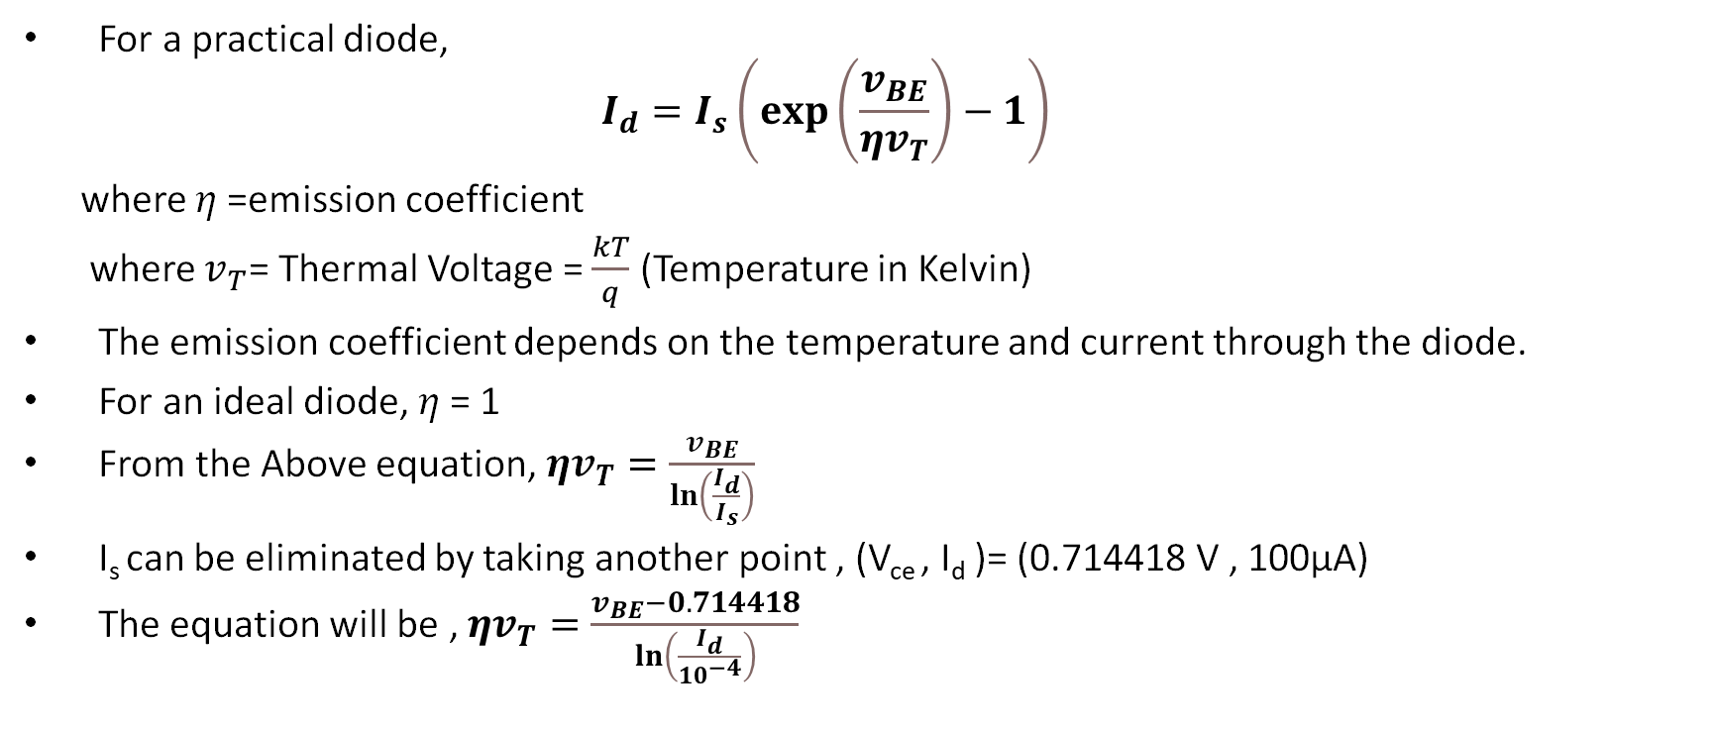
Theory
For a practical diode,
$$I_{d}=I_{s}\left(\exp\left(\frac{v_{BE}}{ηv_{T}}\right)−1\right)$$
where $η$=emission coefficient
where $v_{T}$= Thermal Voltage = $\frac{kT}{q}$ (Temperature in Kelvin)
The emission coefficient depends on the temperature and current through the diode.
For an ideal diode, $η$= 1
From the Above equation, $ηv_{T}=\frac{v_{BE}}{\ln\left(\frac{I_{d}}{I_{s}}\right)}$
I_{s} can be eliminated by taking another point , (V_{ce} , I_{d} )= (0.714418 V , 100µA)
The equation will be , $ηv_{T}=\frac{v_{BE}−0.714418}{\ln\left(\frac{I_{d}}{{10}^{−4}}\right)}$

Slide 4
Procedure
The diode circuit was created on LTSpice.
Then I_{d} was varied till 1A and the emission coefficient was plotted against the current through the transistor.
The value of the gain at 1KHz was found from the small signal AC analysis and transient analysis in the common emitter configuration.
The values of gain was found by the AC analysis of the amplifier.

Slide 5
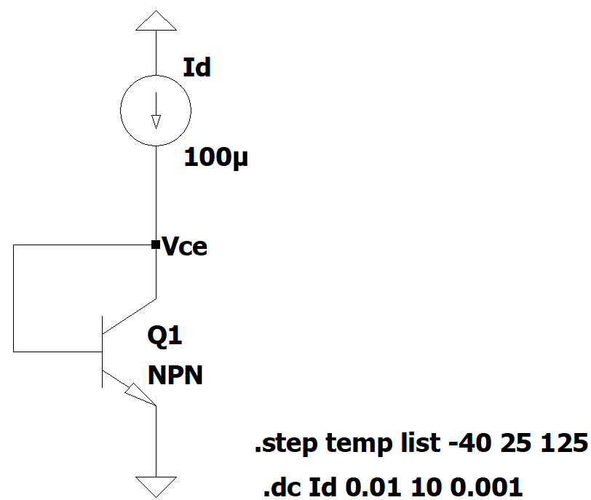
Circuit Diagram
Fig-1.1-BJT in Diode Configuration

Slide 6
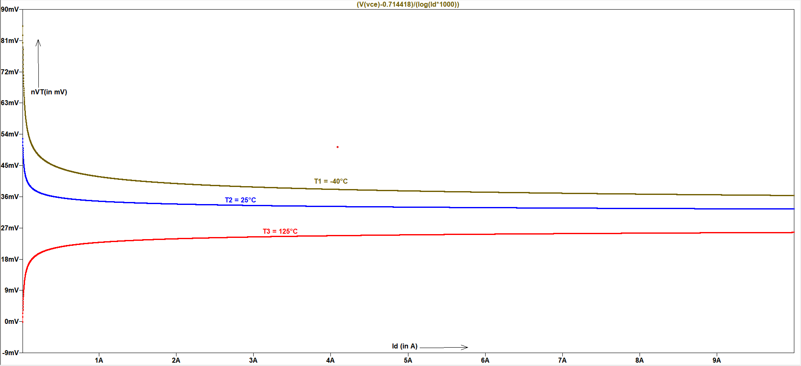

Graph
Fig-1.2-Emission coefficient of a diode vs current through the diode
From the plot , $η$ value decreases with temperature for small values of I_{d} .

Slide 7
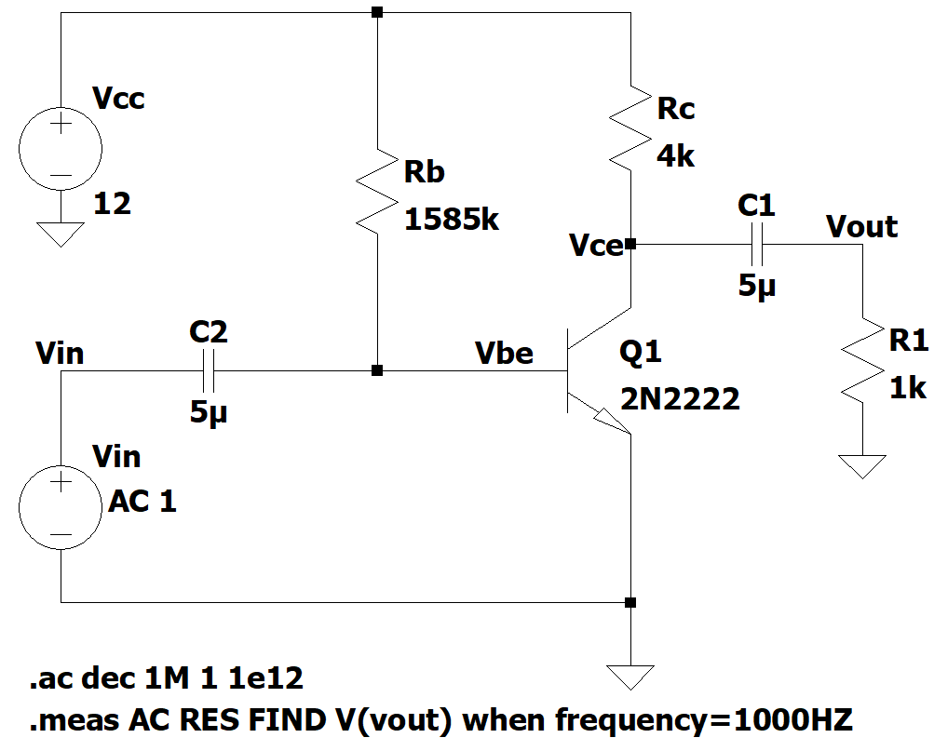
Observing Gain(V/V) at 1KHz Frequency
Fig-1.3-Frequency response of the common emitter amplifier
After running the above command , the output will be res: v(vout)=(33.0615dB,-179.123°) at 1000.
The gain is 33.0615dB and the phase of gain is -179.123°.

Slide 8
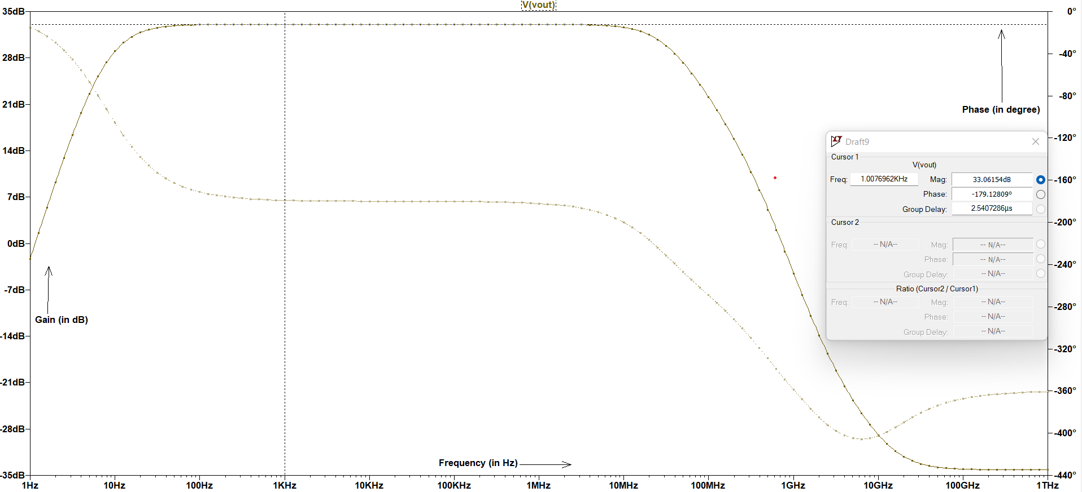
Small Signal AC analysis (Gain and Phase Plot)
Fig-1.4-Small Signal AC analysis C₁=5µF and C₂=5µF

Slide 9
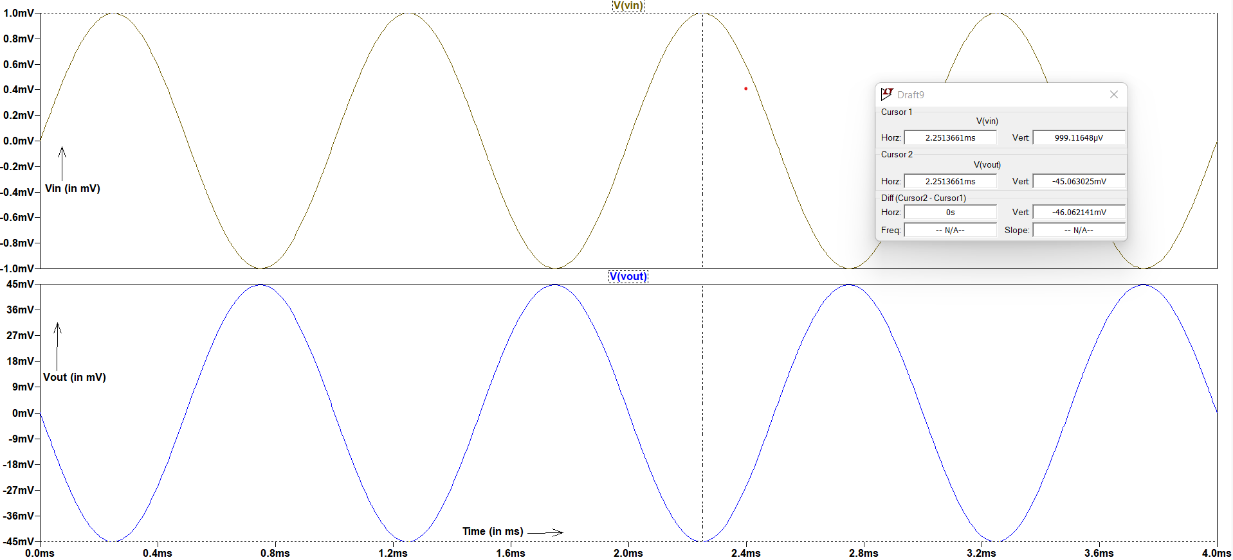
Verification of Gain using a Sinusoidal Input Signal
Fig-1.5-Input and Output waveforms

Slide 10
Calculation
Here, when the input is 1mV, we get an output of 45.063mV which is inverted (i.e. 180 degree phase shift).
Hence the amplitude gain is –45.603 V/V which is 33.076dB.
At the operating frequency of 1kHz, we get an amplitude gain of 33.061dB, which comes out to be –44.983 V/V.
Since the calculated gain and the gain observed from the graph is nearly the same, the output is verified.

Slide 11
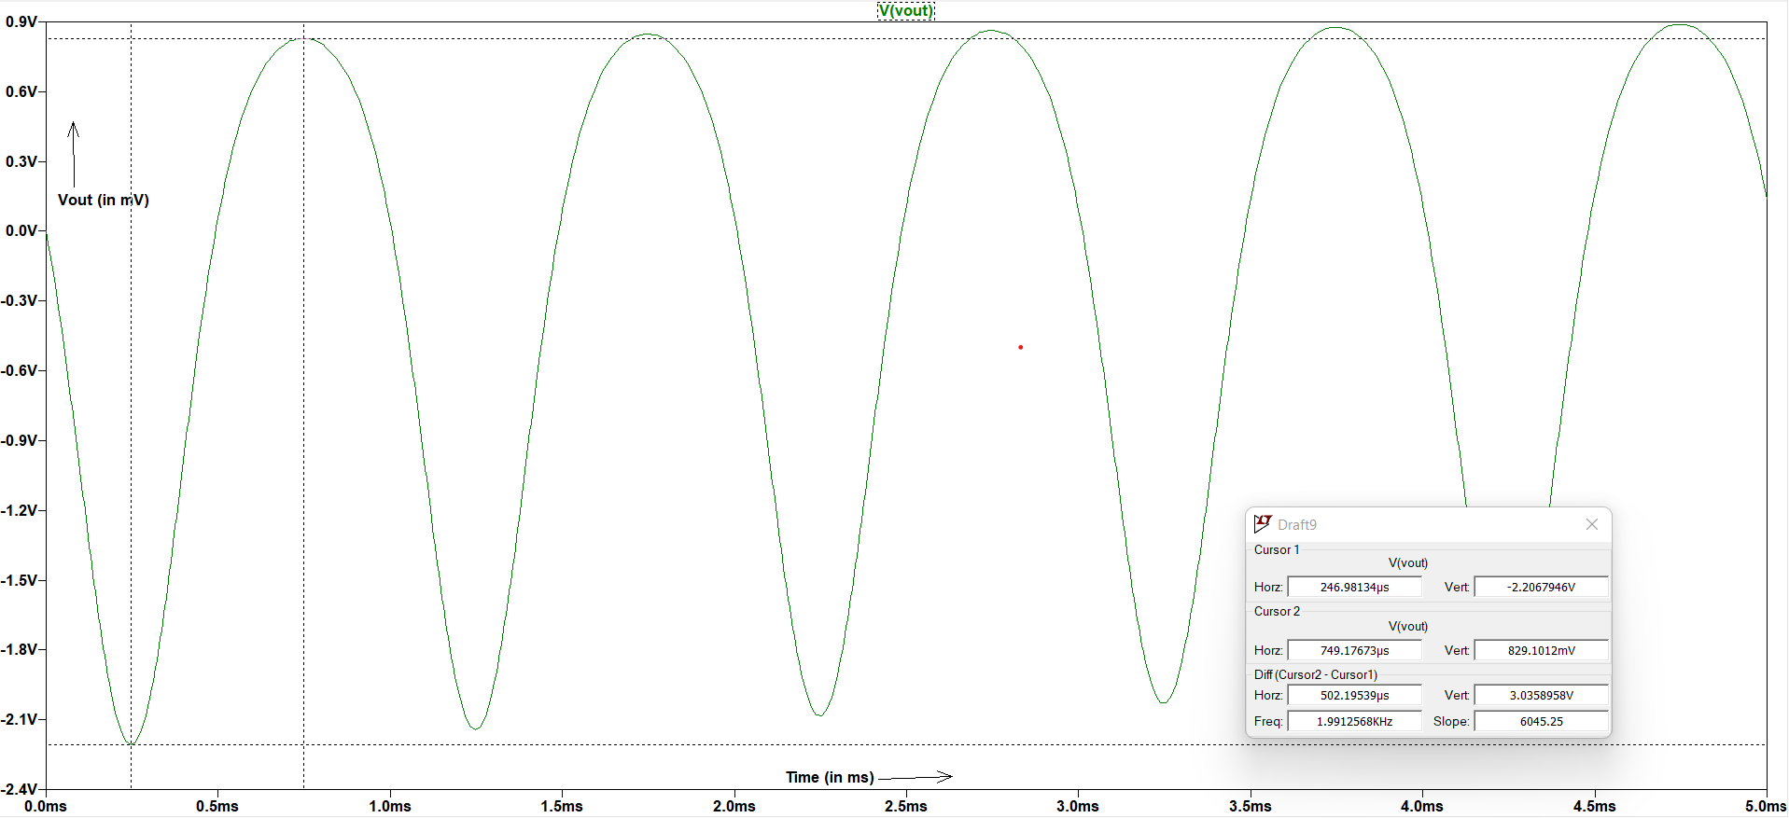
Maximum Output Swing
Fig-1.6-Maximum Output Swing from Transient analysis(without distortion)
The maximum output swing was found at the input of 20mV of sinusoidal signal.
The maximum output swing is about 3.0358V.

Slide 12
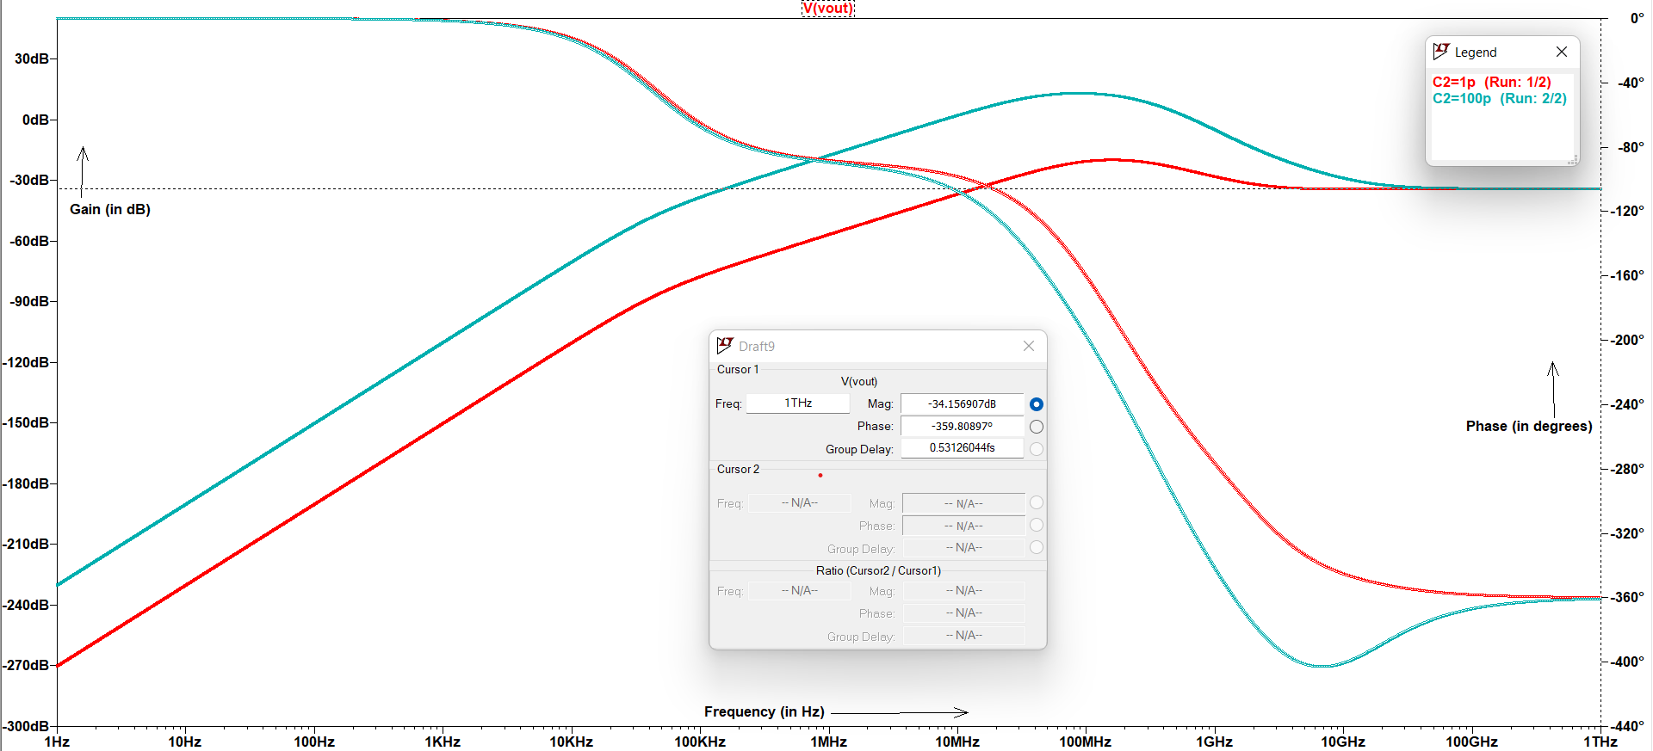
Filter Characteristics
Fig-1.5- Filter Characteristics (AC Analysis) When C1 = 100pF
As from the graph when we use C2 = 1pF , the filter won’t achieve 0 dB gain at any frequency.
The final gain of both the filters are same ( -34.156 dB , -359.8° ).

Slide 13
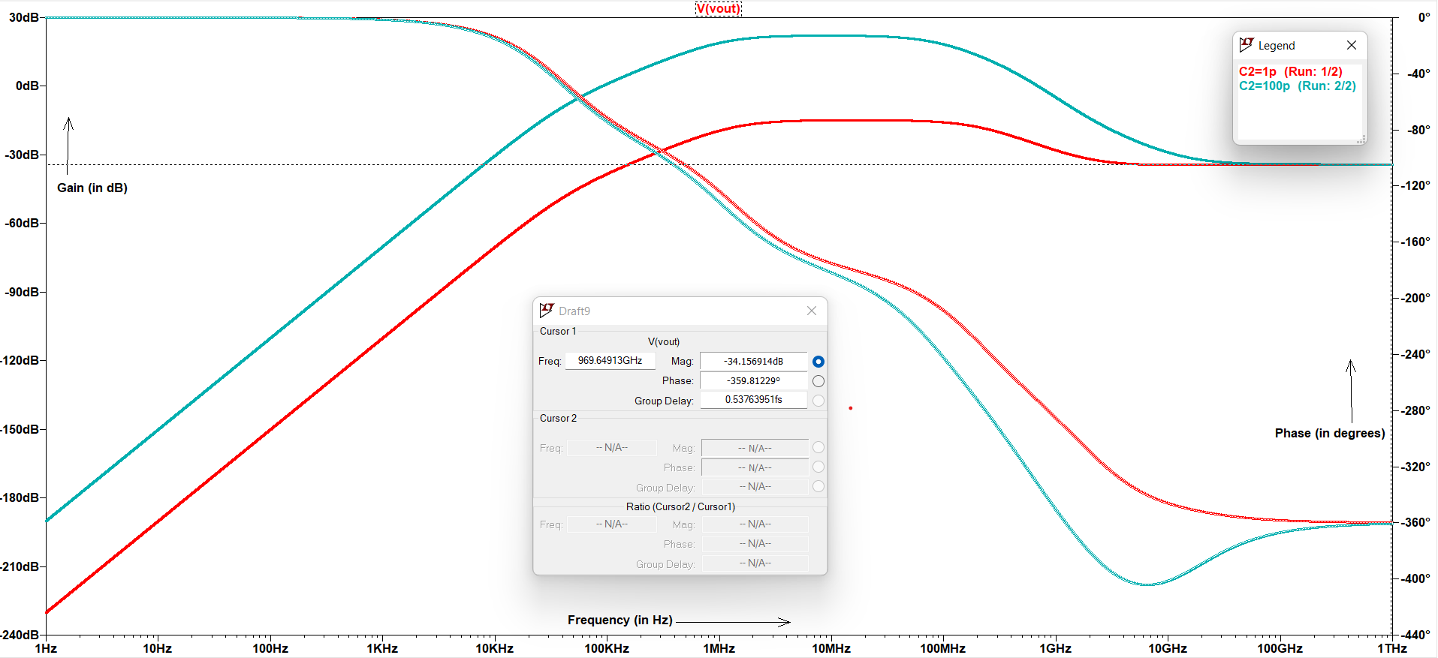
Filter Characteristics
Fig-1.5- Filter Characteristics (AC Analysis) When C1 = 1pF
As from the graph when we use C2 = 1pF , the filter won’t achieve 0 dB gain at any frequency.
The final gain of both the filters are same ( -34.156 dB , -359.8° ).

Slide 14
Observations
The change in coupling capacitance will not affect the gain in the band-width region and at other frequencies , the increase in frequency increases the gain.
An increase in coupling capacitance decreases the cut-off frequency.

Slide 15
Thank You !

